Slide 1
Overfitting, underfitting, Best Fitting, Bias, Variance, Regularization

Slide 2

Overfitting, Underfitting and Best fitting

Slide 3
Overfitting
Overfitting occurs when a statistical model or machine learning algorithm captures the noise of the data. Intuitively, overfitting occurs when the model or the algorithm fits the data too well. Specifically, overfitting occurs if the model or algorithm shows low bias but high variance. Overfitting is often a result of an excessively complicated model, and it can be prevented by fitting multiple models and using validation or cross-validation to compare their predictive accuracies on test data.

Slide 4
Underfitting
Underfitting occurs when a statistical model or machine learning algorithm cannot capture the underlying trend of the data. Intuitively, underfitting occurs when the model or the algorithm does not fit the data well enough. Specifically, underfitting occurs if the model or algorithm shows low variance but high bias. Underfitting is often a result of an excessively simple model.
Both overfitting and underfitting lead to poor predictions on new data sets.

Slide 5
Bias
What is Bias?
Bias is the difference between the average prediction of our model and the correct value which we are trying to predict. A model with high bias pays very little attention to the training data and oversimplifies the model.
Simple definition: “Resulted Error from Training Data!”

Slide 6
Variance
What is a Variance?
Variance is the variability of model prediction for a given data point or a value that tells us the spread of our data. A model with high variance pays a lot of attention to training data and does not generalize on the data which it hasn’t seen before.
Simple definition: “Resulted Error from Test Data!”

Slide 7
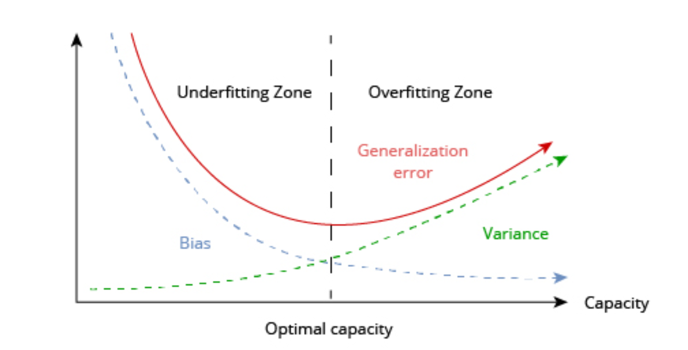
Bias, Variance, Overfitting, Underfitting, Capacity

Slide 8
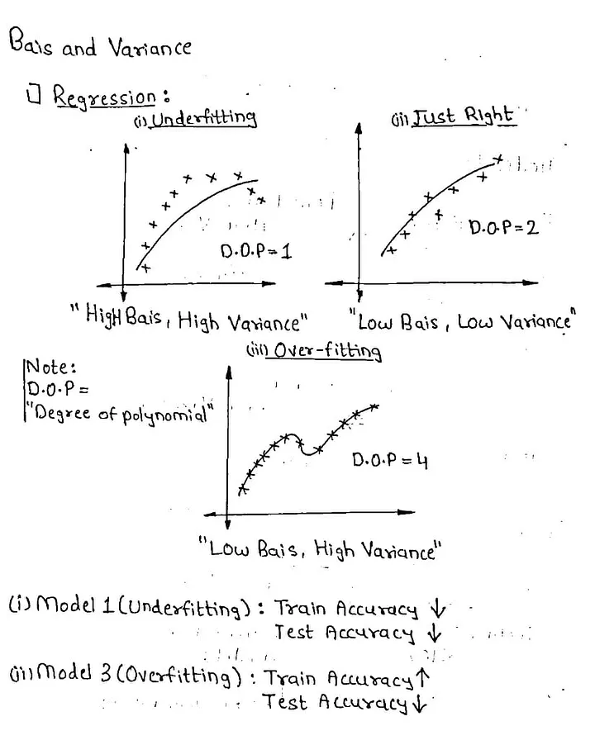
Considering Regression models:
Low Bias-low training error
Low Variance-low testing error
“Bias is Error resulted from Training set, while Variance is error resulted from Test set!”

Slide 9
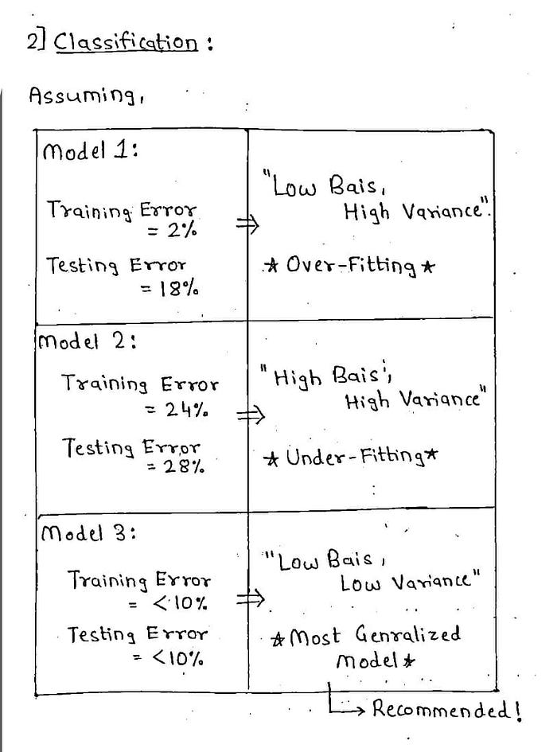
Overfitting, Underfitting and Best fit in classification problem Like
(SVM, KNN, Naïve Bayes, Random Forest, Decision Tree)

Slide 10
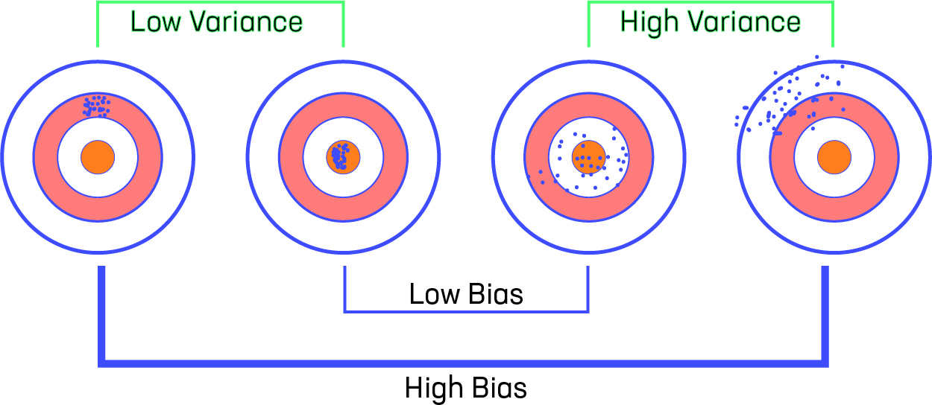
Visualization of Bias and Variance

Slide 11
Regularization
How does Regularization Work?
Regularization works by adding a penalty or complexity term to the complex model. Let's consider the simple linear regression equation:
y= β0+β1x1+β2x2+β3x3+⋯+βnxn +b
In the above equation, Y represents the value to be predicted
X1, X2, …Xn are the features for Y.
β0,β1,…..βn are the weights or magnitude attached to the features, respectively. Here represents the bias of the model, and b represents the intercept.
Linear regression models try to optimize the β0 and b to minimize the cost function. The equation for the cost function for the linear model is given below:
Now, we will add a loss function and optimize parameter to make the model that can predict the accurate value of Y. The loss function for the linear regression is called as RSS or Residual sum of squares.

Slide 12

Types of Regularization
Ridge
Lasso
Ridge Regression
Ridge regression is one of the types of linear regression in which a small amount of bias is introduced so that we can get better long-term predictions.
Ridge regression is a regularization technique, which is used to reduce the complexity of the model. It is also called as L2 regularization.
In this technique, the cost function is altered by adding the penalty term to it. The amount of bias added to the model is called Ridge Regression penalty. We can calculate it by multiplying with the lambda to the squared weight of each individual feature.
The equation for the cost function in ridge regression will be:

Slide 13
In the above equation, the penalty term regularizes the coefficients of the model, and hence ridge regression reduces the amplitudes of the coefficients that decreases the complexity of the model.
As we can see from the above equation, if the values of λ tend to zero, the equation becomes the cost function of the linear regression model. Hence, for the minimum value of λ, the model will resemble the linear regression model.
A general linear or polynomial regression will fail if there is high collinearity between the independent variables, so to solve such problems, Ridge regression can be used.
It helps to solve the problems if we have more parameters than samples.

Slide 14

Lasso Regression:
Lasso regression is another regularization technique to reduce the complexity of the model. It stands for Least Absolute and Selection Operator.
It is similar to the Ridge Regression except that the penalty term contains only the absolute weights instead of a square of weights.
Since it takes absolute values, hence, it can shrink the slope to 0, whereas Ridge Regression can only shrink it near to 0.
It is also called as L1 regularization. The equation for the cost function of Lasso regression will be:
Some of the features in this technique are completely neglected for model evaluation.
Hence, the Lasso regression can help us to reduce the overfitting in the model as well as the feature selection.

Slide 15
Key Difference between Ridge Regression and Lasso Regression
Ridge regression is mostly used to reduce the overfitting in the model, and it includes all the features present in the model. It reduces the complexity of the model by shrinking the coefficients.
Lasso regression helps to reduce the overfitting in the model as well as feature selection.

